Slide 1

Using Social Media to Assess Neighborhood Social Disorganization
A Case Study in the United Kingdom
Diogo F. Pacheco, Marcos Oliveira, Ronaldo Menezes
Florida Institute of Technology
AAAI Publications, The Thirtieth International Flairs Conference

Slide 2


Slide 3


Slide 4
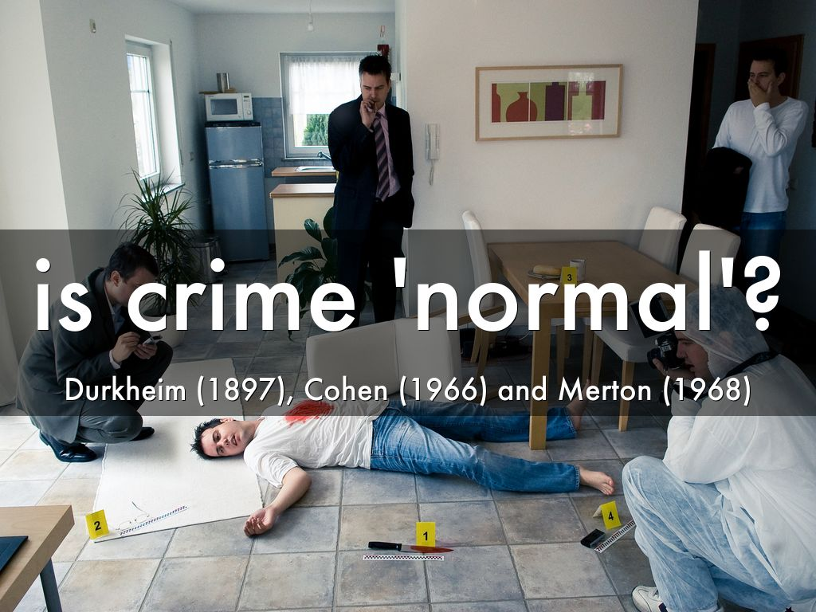

Slide 5
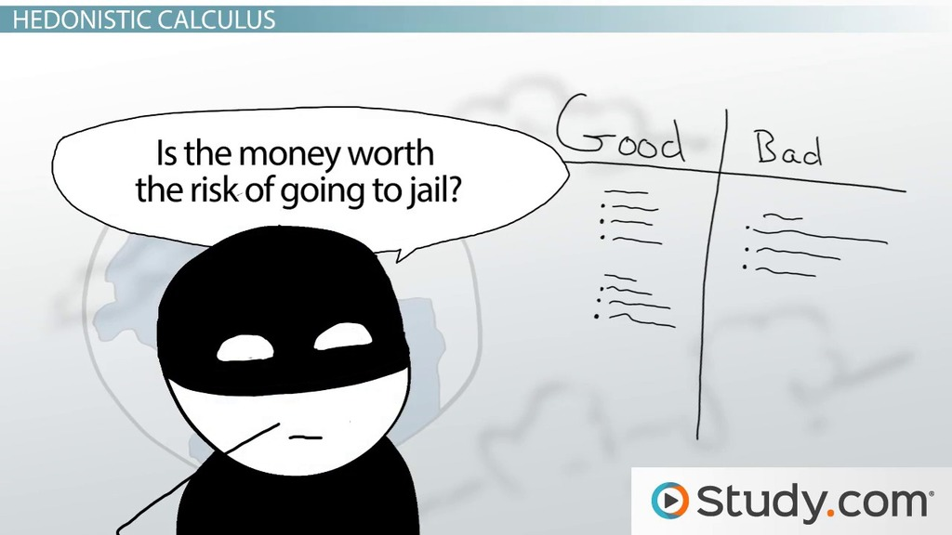

Slide 6
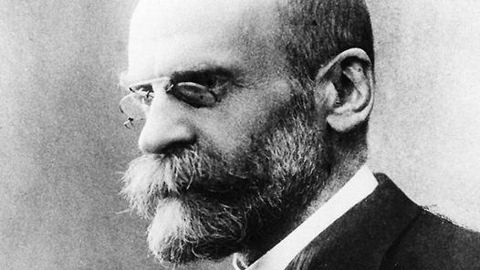
Crime is normal, inevitable, and functional... A certain amount of crime is an integral part of all healthy societies...

Slide 7
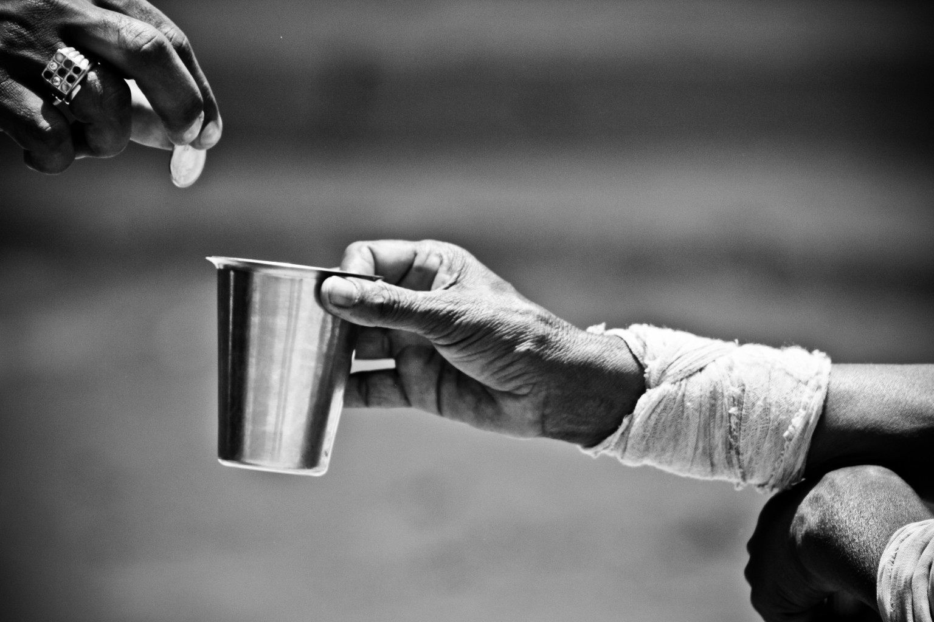
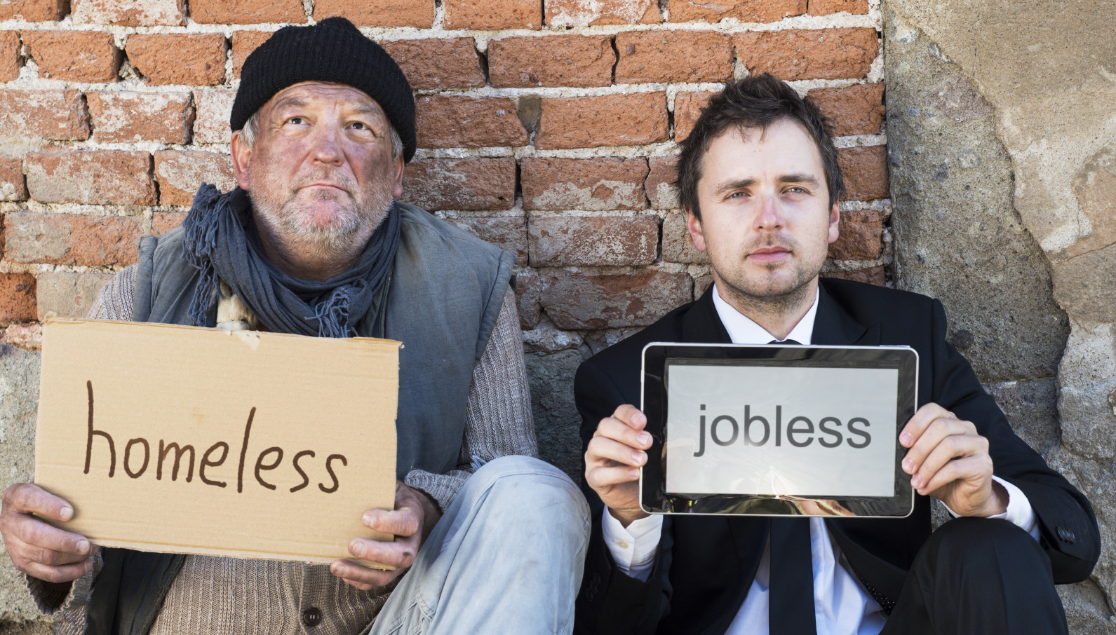
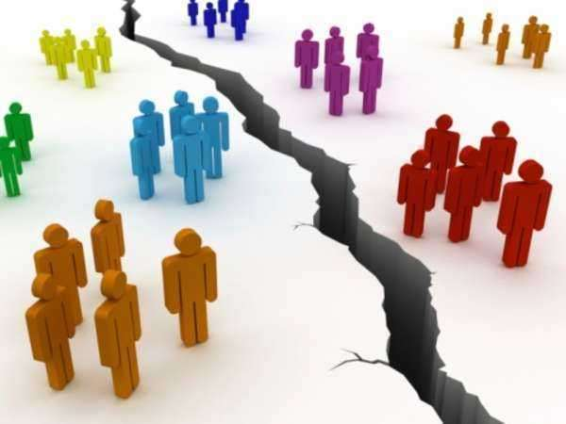
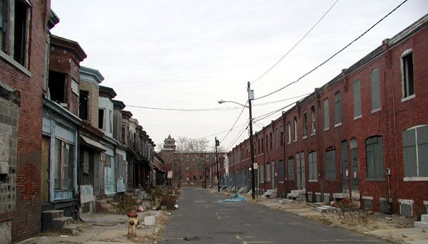


Slide 8

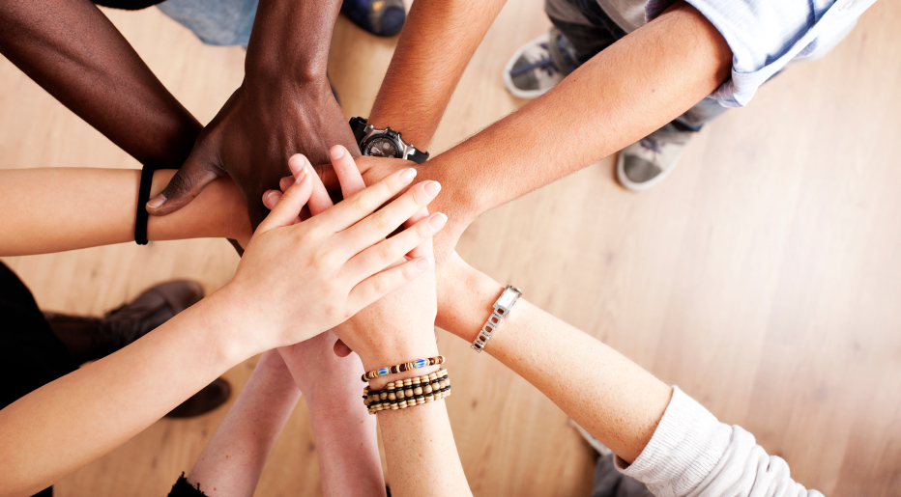

Slide 9
Introduction
Social disorganization
Crime
Social media as a proxy for society?

Slide 10
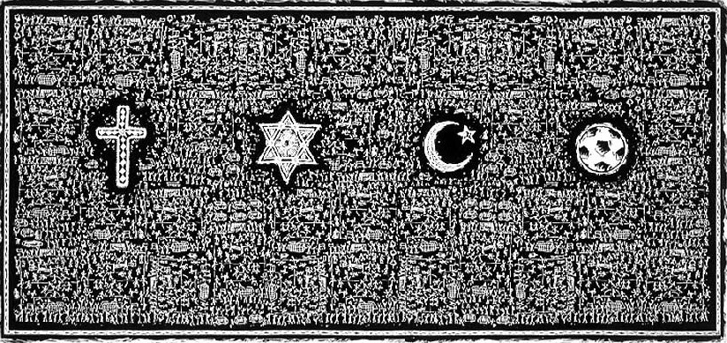
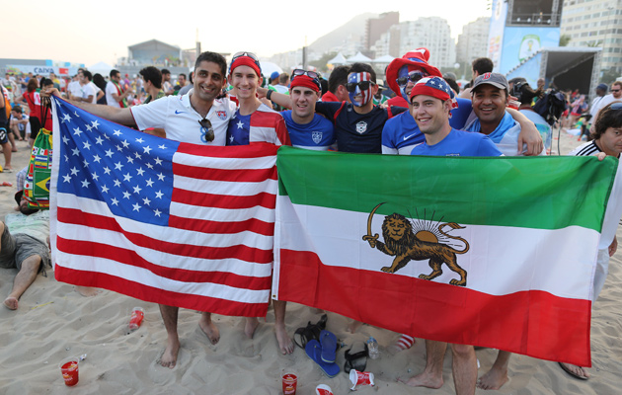
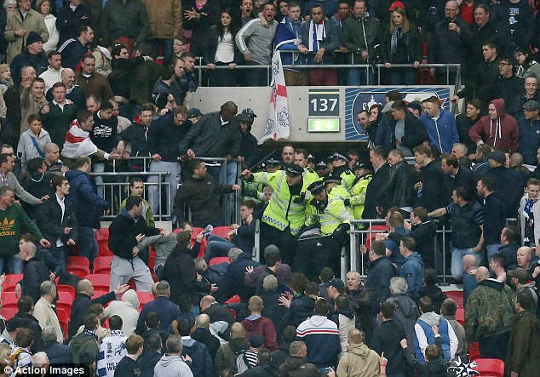

Slide 11
Introduction
Social disorganization
Crime
Social media as a proxy for society?
Twitter Football Social Disorganization Crime?

Slide 12
Approach

Slide 13
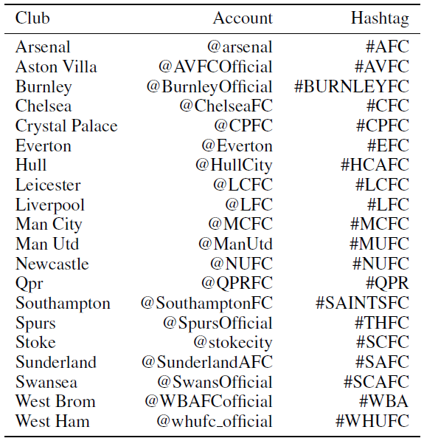
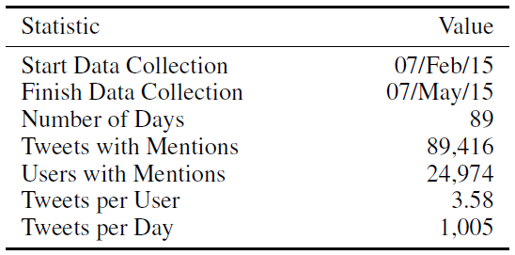
Approach
Datasets – Twitter

Slide 14
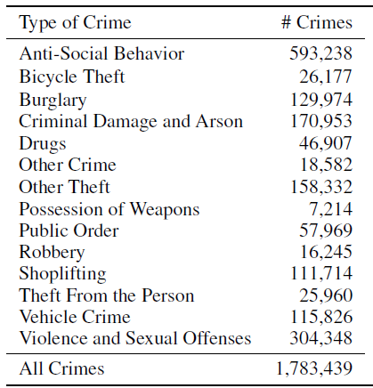
Approach
Datasets – Crime (data.gov.uk)

Slide 15
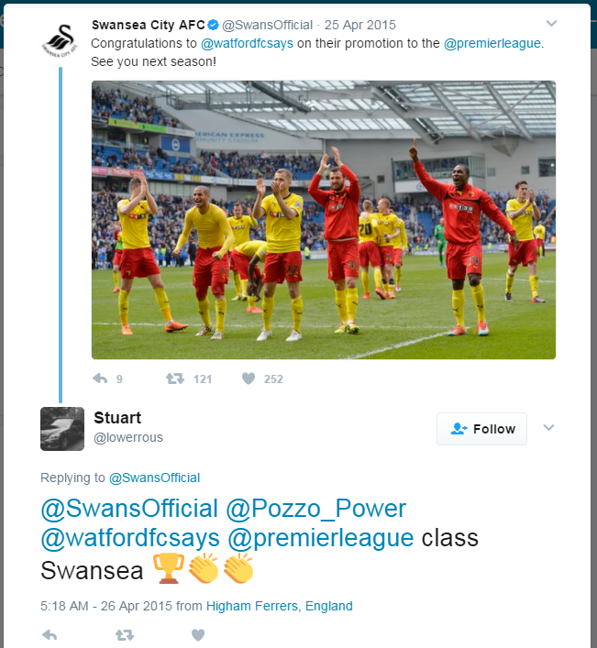
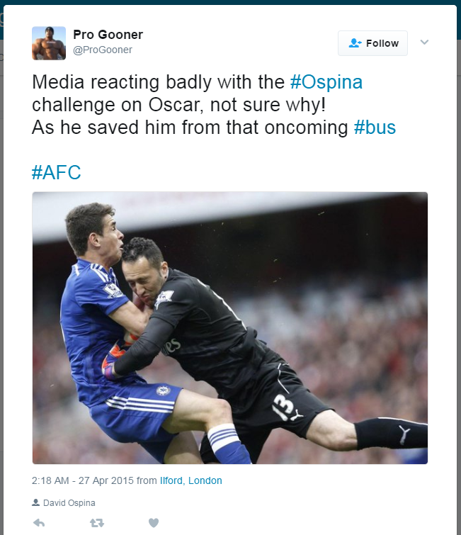
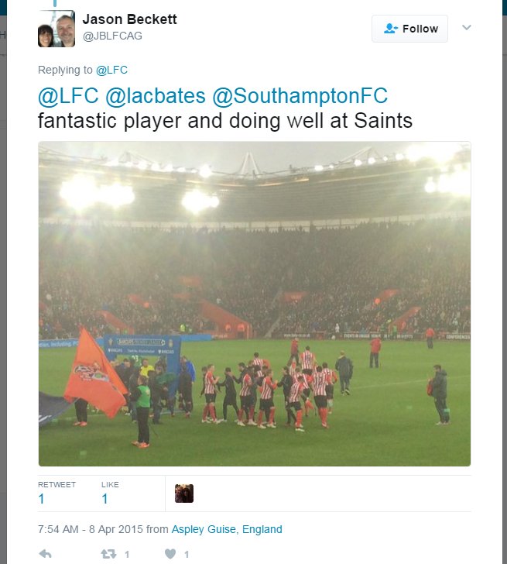
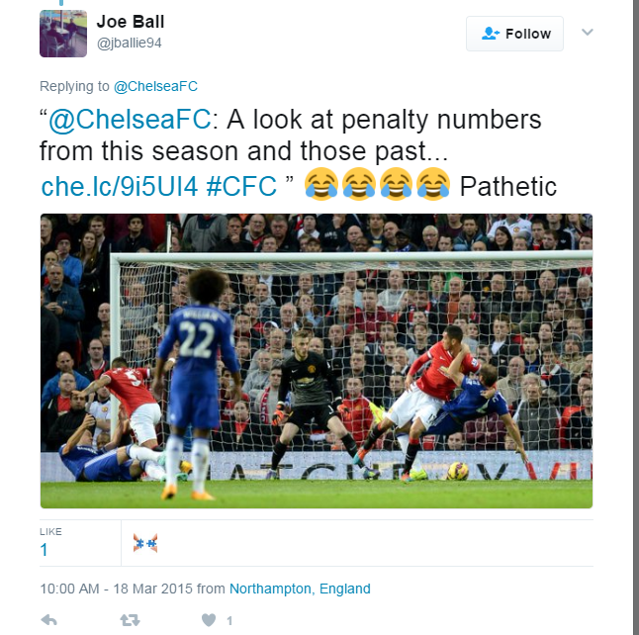
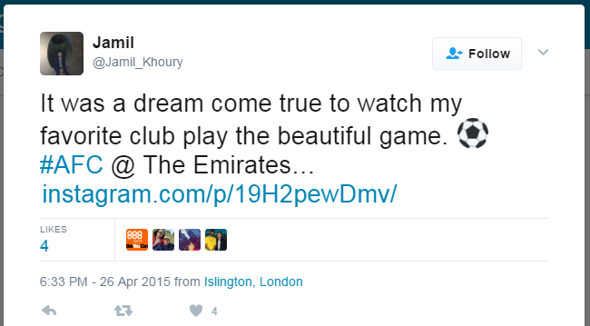
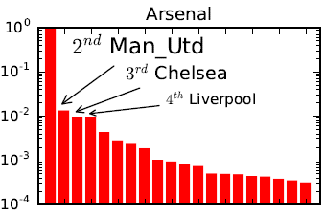
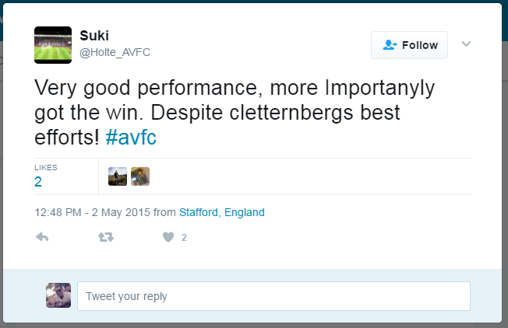
Approach
Characterizing users

Slide 16

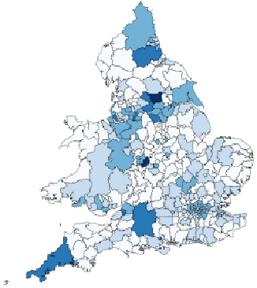
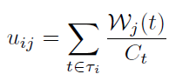
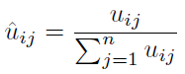
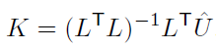
Approach
Characterizing users and regions
Local
1 charac. per user and per region (LSOA)

Slide 17
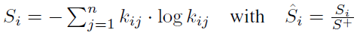
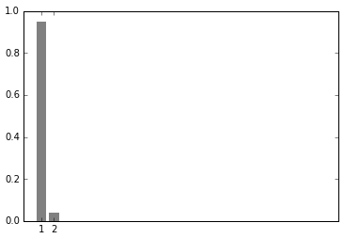
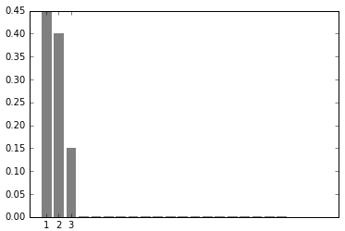
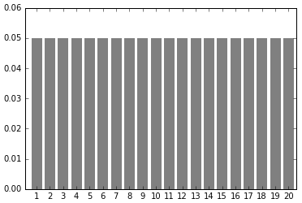
Approach
The Entropy of Football Supporters in a region
More clubs being mentioned, greater entropy.

Slide 18
results

Slide 19
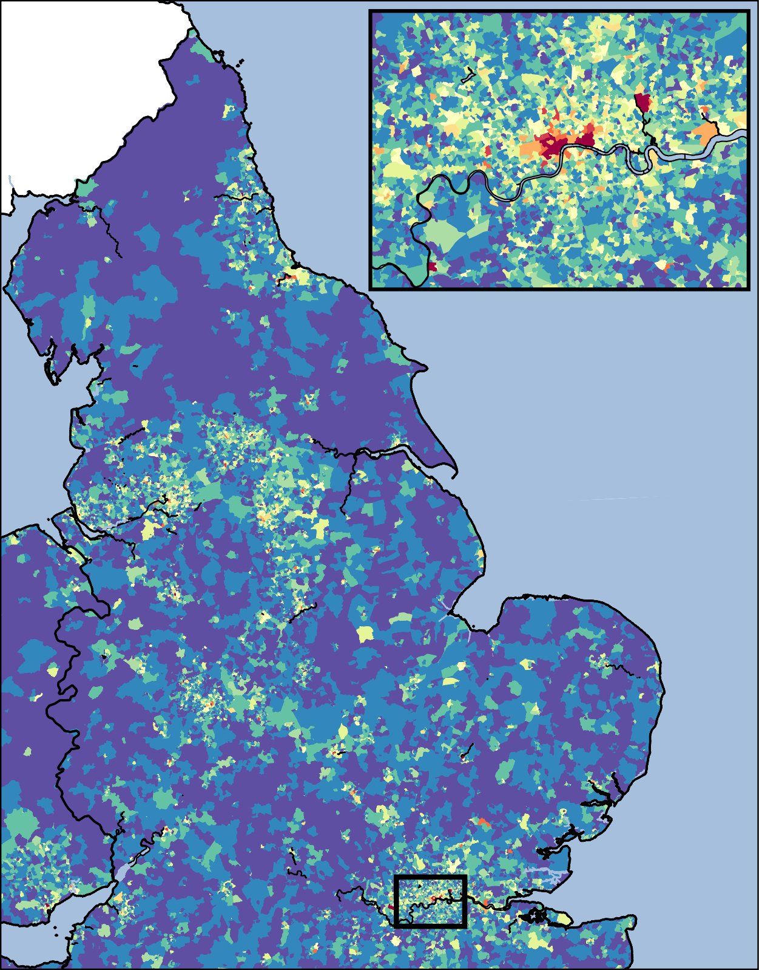
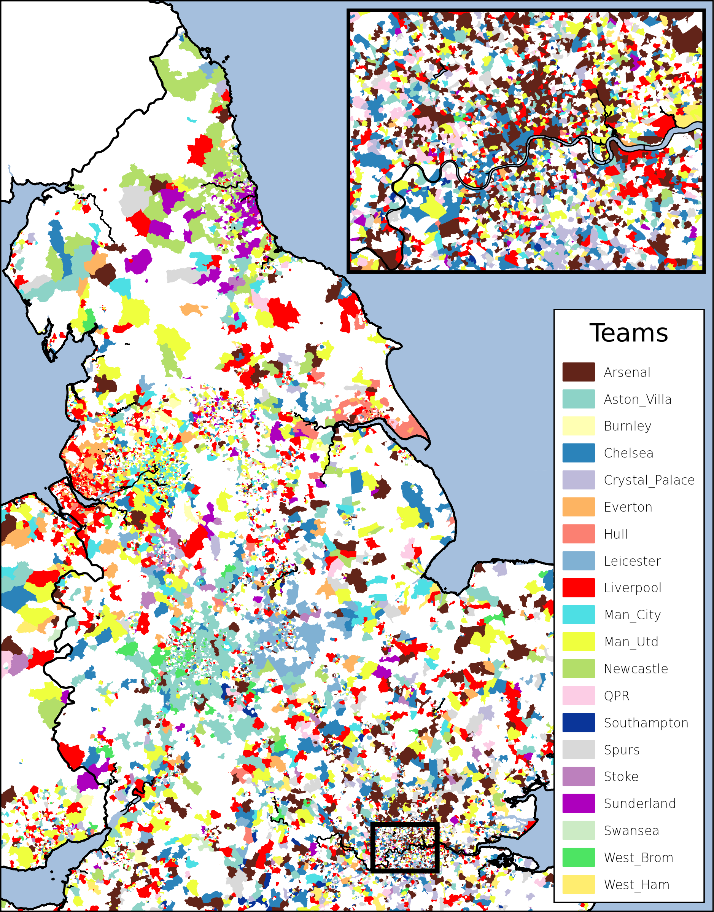
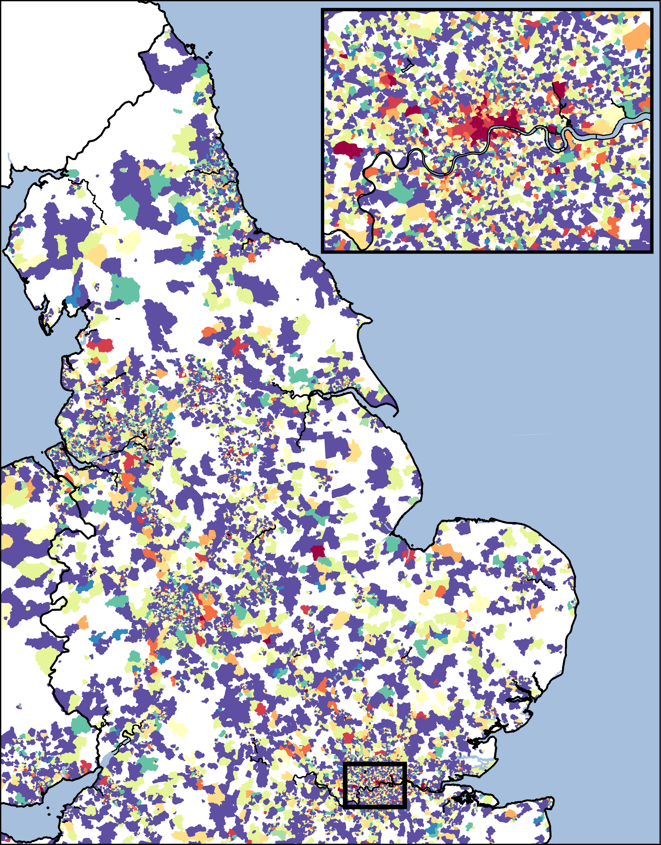
Results
Crime Concentration | Characterization | Entropy of Supporters
High
Low

Slide 20
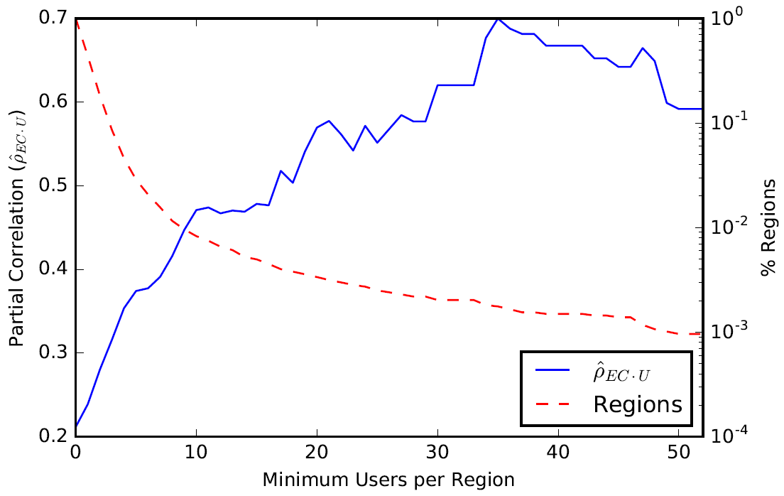
results
Partial Correlation (Crime,Entropy | Users)

Slide 21
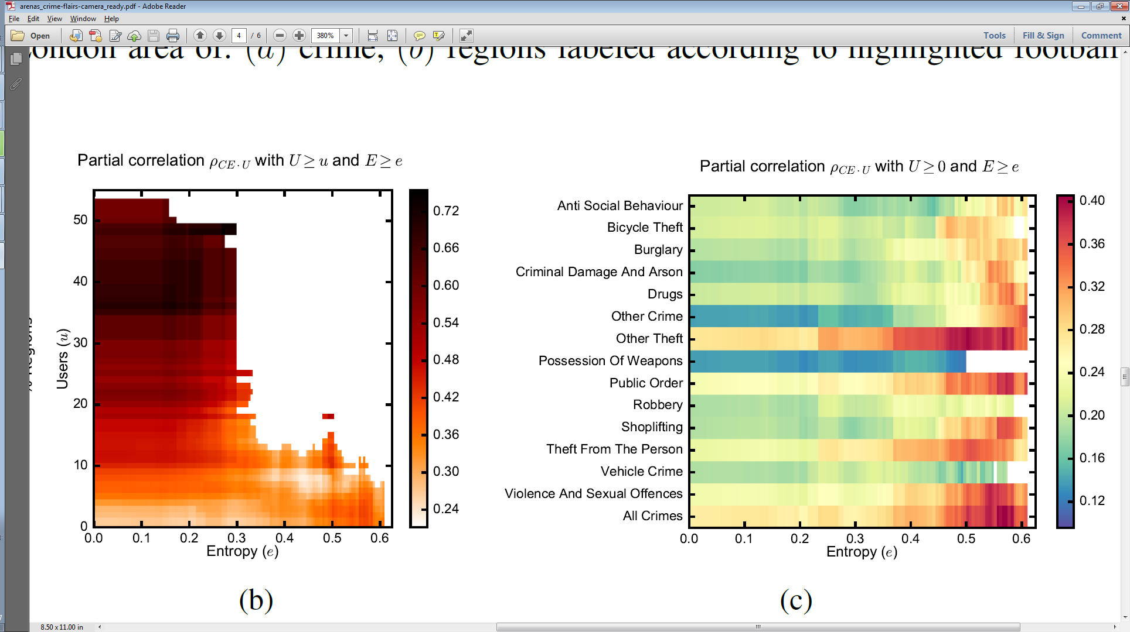
results
Partial Correlation Analysis

Slide 22
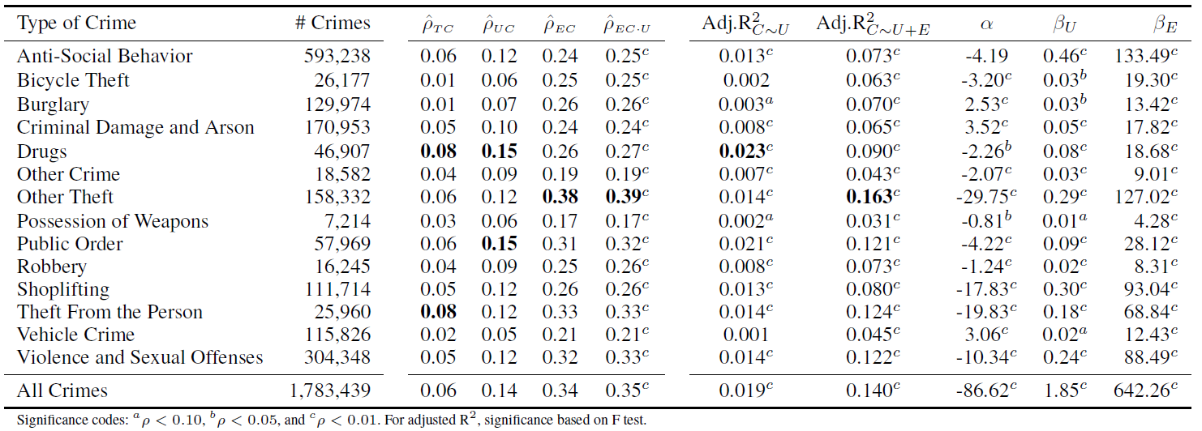
results
Regression Analysis

Slide 23
conclusions

Slide 24
conclusions
We proposed a measure for social disorganization in a region using social media.
Significant correlation between:
#users and #crime
Entropy of supporters and crime
Partial corr, isolating #users (population)
Higher correlation in regions more disorganized and populated.
Regression models, significant coefficients regardless the type of crime, and 7x better with entropy.

Slide 25
Future works
Other datasets
Longitudinal data
Global vs. Local characterization
Twitter Football Social Disorganization Crime?
Language?
Real estate?
?
?

Slide 26
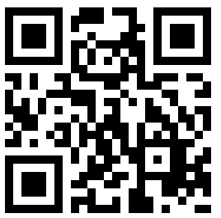
Using Social Media to Assess Neighborhood Social Disorganization
A Case Study in the United Kingdom
Questions?
Diogo F. Pacheco – http://diogofpacheco.github.io
dpacheco@biocomplexlab.org

